Slide 1
Welcome Back – Part 3 Jerusalem Is Rebuilt
Ezra, Nehemiah, Esther, Haggai, Zechariah, Malachi

Slide 2
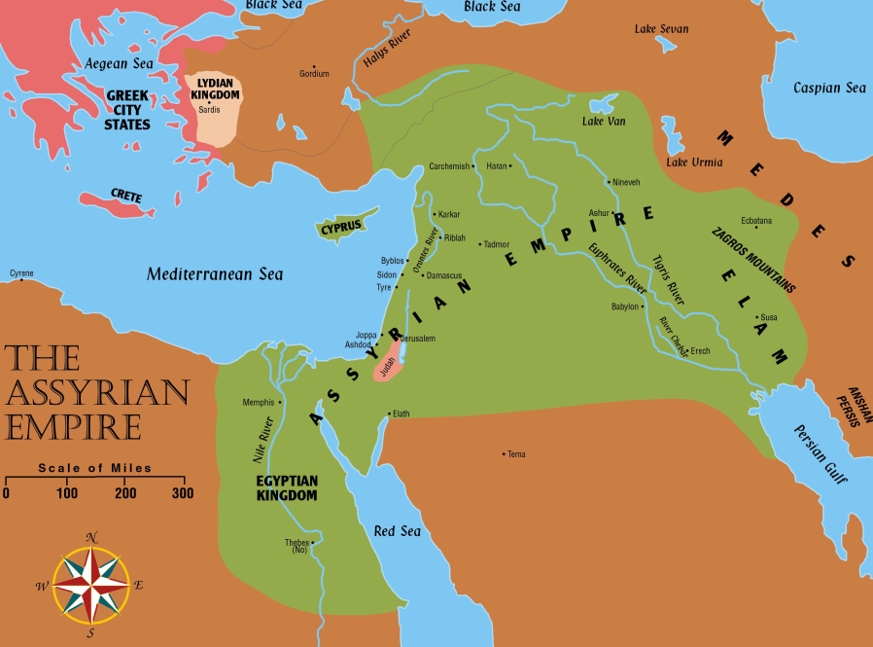
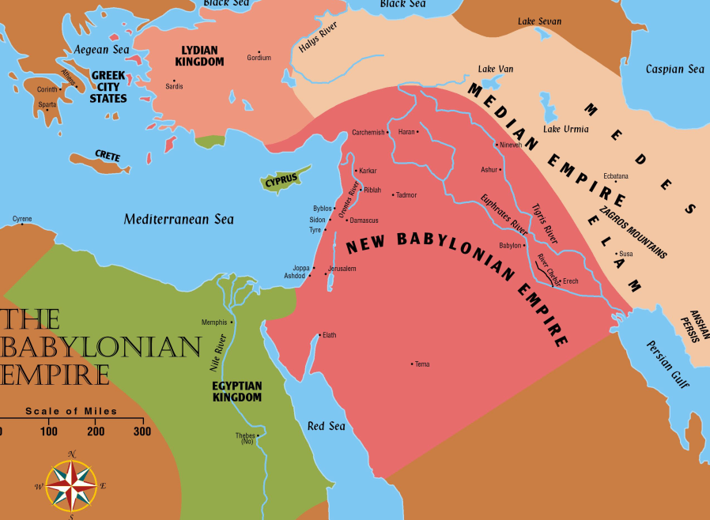
Jerusalem Is Rebuilt
Permission to go home included all the tribes of the Israelites. Ezra 1:3
Israel (Northern tribes) was scattered throughout the Assyrian empire
Judah (Southern tribes) scattered in Babylon

Slide 3
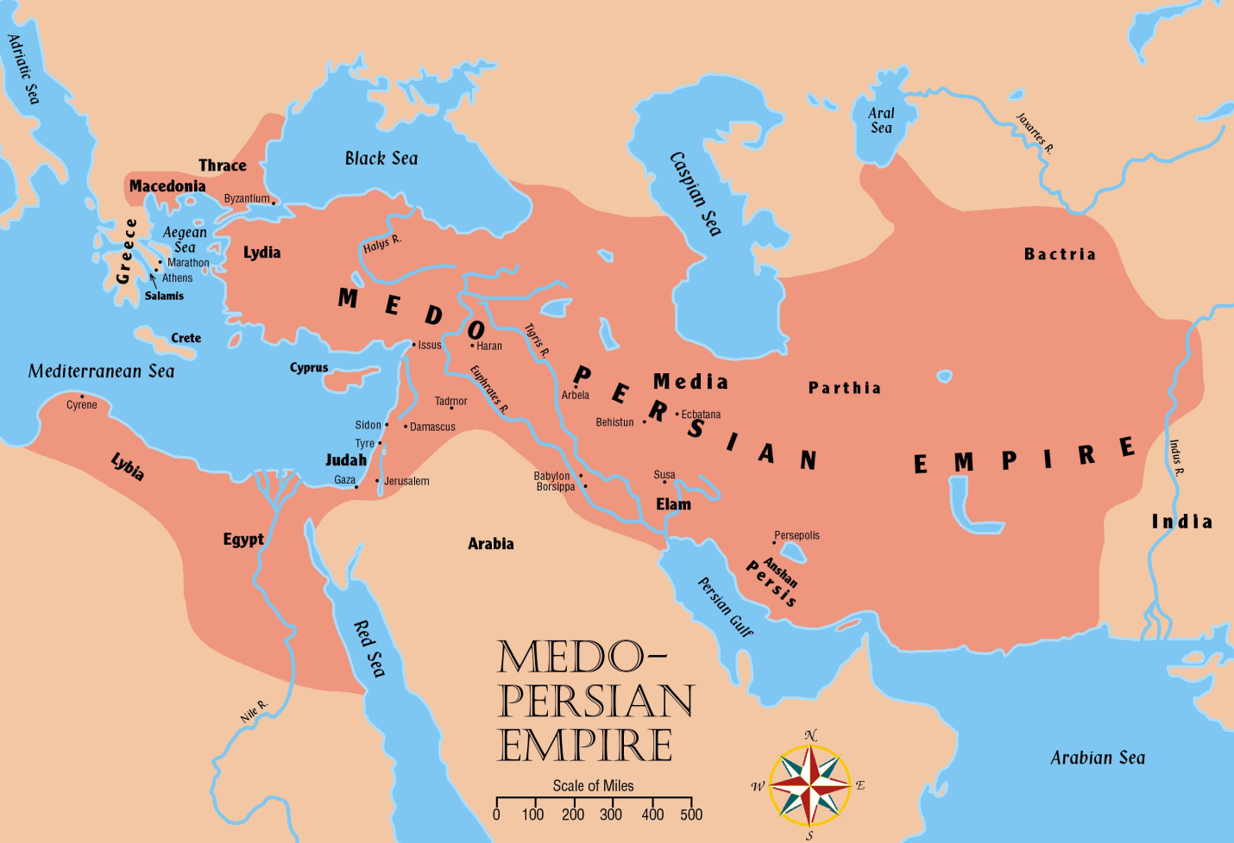
Jerusalem Is Rebuilt
Persia now controls all the territories once held by Assyrian and Babylonian empires

Slide 4
Captives Free to Return
536 B.C.
Many Israelites stayed where they were
It has been almost 200 years since the first captives have been taken from Israel. 721 BC
The most recent captives have been gone 50 years
They built homes and were content to stay
It was their choice whether to return or not.

Slide 5
Captives Free to Return
536 B.C.
Approximately 50,000 Jews gathered in Babylon to start home (Ezra 2:64-65)
Sheshbazzar (Ezra 1:8, 11; 5:14-15) and Zerubbabel (Ezra 2:2; 3:2, 8; 4:3; 5:2) are named as leaders. (Perhaps same man)
Many valuable vessels taken from the temple and palace in Nebuchadnezzar’s day are returned. Ezra 2:68-69
5,400 gold and silver vessels returned
Jews who stayed behind helped their brethren with gifts to make their trip easier. Ezra 1
It was a day of great joy as they began the trip
However, the tasks ahead would not be easy

Slide 6
The People of Palestine
They profited from the Jews’ absence
Samaritans, Ammonites, Edomites, and Nomadic tribes moved into and nearer the fertile lands

Slide 7
The “three returns” in Ezra and Nehemiah:
Jews return home under the leadership of Zerubbabel to build the temple. (Book of Haggai) cf. Ezra 3:10ff; cf. Haggai 2:3
Ezra returns with the priests to start the spiritual reform. Ezra 3
Nehemiah returns to build the walls. (Book of Nehemiah)
Adversaries: Samaritans desired to help build the temple. Ezra 4:1ff; Nehemiah 2:17ff; cf. 2 Kings 17:32.
Jews accused of treason. Ezra 4:6ff; 11ff

Slide 8
Return Number ONE
Enemies wrote a letter to the new king Cambyses (Cyrus’ son) after Cyrus had died
Asked the king to check the records to see if Jerusalem had not always been rebellious. Ezra 4:15
Cambyses checked and he found that Jerusalem had been rebellious. Ezra 4:17ff
As a result, he had the work stopped and nothing more was accomplished for 16 years. Ezra 4:21
The people built houses for themselves, yet did not prosper. Haggai 1:2-11

Slide 9
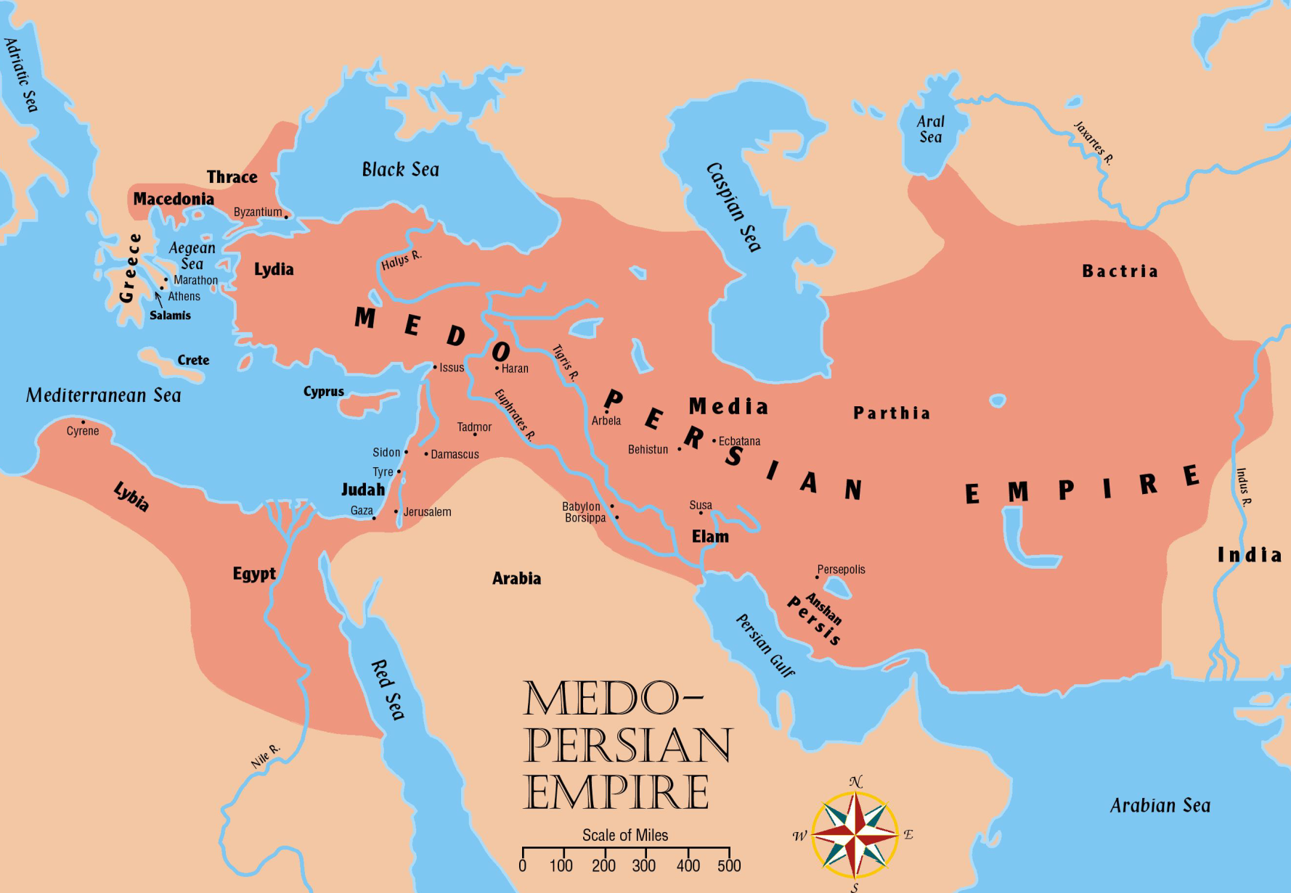
Return Number ONE
Darius conquered new territories
A wise administrator
Initiated many legal and fiscal reforms in the land to promote commerce
Built roads
Established an efficient postal system
Built a canal connecting Gulf of Suez to the Mediterranean Sea
Judah was a tiny dependency in an empire of 2,000,000 square miles

Slide 10
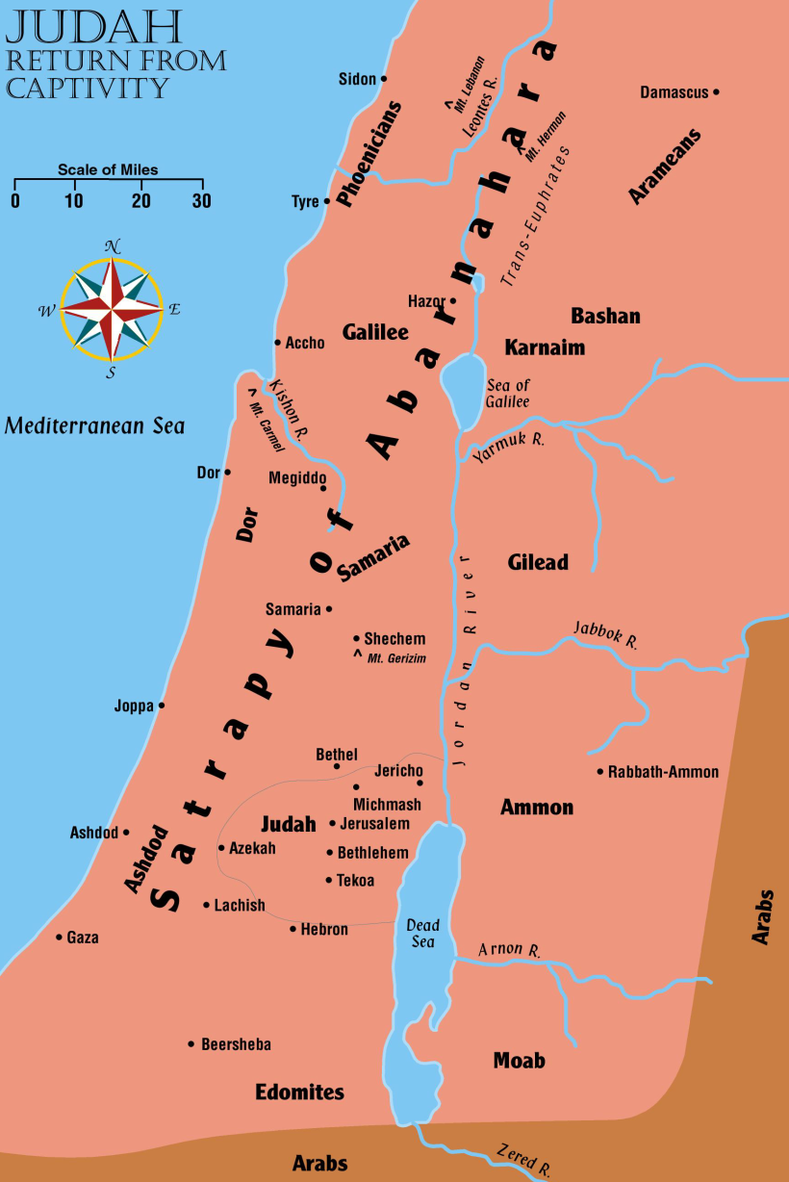
Return Number ONE
When king Darius the Great (Cyrus’ grandson) came to power, Haggai and Zechariah urged the people to resume work
The people really needed this encouragement

Slide 11
Return Number ONE
A new letter is sent to the king telling the story of Jerusalem correctly (Ezra 5)
Darius checked the records and found the original decree from Cyrus in the palace of Achmetha in Media
He gave orders for the work to be finished and he forbade ANY opposition. (Ezra 6:1-2)
The temple was finished 20 years after it was begun
A total of 4 years labor time (515 BC)

Slide 12
Esther
Takes place approximately between chapters 6 and 7 of the book of Ezra
After king Darius I (521-486 BC)
Xerxes comes to the throne (486-465 BC)
Esther becomes queen to Xerxes
Risks her life and spares her people from annihilation
Her uncle Mordecai is raised to a highly responsible position in the kingdom – Jews treated with more respect

Slide 13
God’s Providence: The Story of Esther
“Then Mordecai bade them return answer unto Esther, Think not with thyself that thou shalt escape in the king's house, more than all the Jews. For if thou altogether holdest thy peace at this time, then will relief and deliverance arise to the Jews from another place, but thou and thy father's house will perish: and who knoweth whether thou art not come to the kingdom for such a time as this?”
Esther 4:13-14

Slide 14
Reminder
Ecclesiastes 9:1, “For all this I laid to my heart, even to explore all this: that the righteous, and the wise, and their works, are in the hand of God.”
Ecclesiastes 3:11, “Man cannot find out the work that God hath done from the beginning even to the end.”

Slide 15
Reminder
Deuteronomy 29:29, “The secret things belong unto Jehovah our God; but the things that are revealed belong unto us and to our children for ever, that we may do all the words of this law.”
Therefore we “walk by faith, not by sight” (2 Corinthians 5:7), we “Trust in Jehovah with all thy heart, And lean not upon thine own understanding: In all thy ways acknowledge him, And he will direct thy paths.” (Proverbs 3:5-6)

Slide 16
King Xerxes “Ahasuerus”
Made up of 127 provinces
Jews scattered as result of Babylonian captivity (2:5-6)
Reigning King of Persia (486–465 BC)
Unsuccessful war against Greece.

Slide 17
Background
483 BC – royal feast given in Shushan
Lasted 180 days
Women being entertained by Queen Vashti.
King sought to parade Vashti’s beauty after becoming “merry with wine.”
Queen refused the order
Esther 1:12, 19

Slide 18
New Queen
Process took four years. (2:15-20)
Esther is chosen – not yet revealed her Jewish heritage. (2:10)
Each woman prepared for one year. (2:12)
Then each spent one night with the King.
Those not chosen placed with king’s concubines
Notes:
Selection process

Slide 19
Mordecai
Served as the king’s gatekeeper
Esther 2:5-7
Would not bow down and give homage to Haman.
Revealed plot to the Queen about assassination attempt on the king
Esther 2:19-23

Slide 20
Haman
Served as the king’s Prime Minister
Esther 3:1-2
Devised a plot to kill all the Jews
Esther 3:6-9; cf. Genesis 12:1-3
Note Mordecai’s faith in God. (4:14)
King consents to the plot
Esther 3:10-15

Slide 21
God’s Providence: The Story of Esther
“Then Mordecai bade them return answer unto Esther, Think not with thyself that thou shalt escape in the king's house, more than all the Jews. For if thou altogether holdest thy peace at this time, then will relief and deliverance arise to the Jews from another place, but thou and thy father's house will perish: and who knoweth whether thou art not come to the kingdom for such a time as this?”
Esther 4:13-14

Slide 22
Step #1
Esther’s commitment.
Esther 4:14-17
Mordecai’s insistence for her to go before the king
Esther’s choice. Life or riches
Esther’s noble character.
A special banquet
Esther 5:4

Slide 23
Step #2
Events the night before the 1st banquet
Esther 5:9-14 – Haman’s pride / Plot to hang Mordecai
King could not sleep and asked the chronicles be read
Esther 6:1-3; cf. 2:21-23
King’s question to Haman
Esther 6:4ff
Haman’s forced to honor Mordecai
Esther 6:7-12
Wife’s statement
Esther 6:13

Slide 24
Step #3
The 2nd banquet
Esther 6:14 – 7:1
Esther reveals her request to the king
Esther 7:3-6
Haman pleads for his life
Esther 7:6-8
Haman hanged on his own gallows
Esther 7:9-10

Slide 25
Step #4
Mordecai given Haman’s position
Esther 8:1-2
What about the decree?
Esther 8:3-6 – Esther again risks her life.
King sends out a new decree
Esther 8:8-10
Jews given permission to defend themselves
Esther 8:11-17

Slide 26
Can We See God in All of This?
An orphan taken by Mordecai (2:7)
What if she had ended up in the home of other relatives?
What if Esther revealed her identity to the king other than when Mordecai had instructed?
How did it happen that Mordecai sent out the decree that averted the effects of Haman’s decree? (8:3-4, 7-9)
How did Mordecai happen to be the man of wisdom and intelligence involved in this plan?

Slide 27
Can We See God in All of This?
How did Mordecai happen to even be alive at the time to be appointed as Prime Minister?
How come the king had trouble sleeping and asked for the chronicles?
How did the king happen to hear about Mordecai saving his life?
How did it happen that until now the good deed of Mordecai had been overlooked?
How did a young Jewish orphan become Queen over a world empire?

Slide 28
Can We See God in All of This?
Though never named in the book, God is there … in every chapter and every verse; in every event we have looked at, all to the bringing about of good for His people.
“For if thou altogether holdest thy peace at this time, then will relief and deliverance arise to the Jews from another place, but thou and thy father’s house will perish: and who knoweth whether thou art not come to the kingdom for such a time as this?” Esther 4:13-14

Slide 29
Reminder
Ecclesiastes 9:1, “For all this I laid to my heart, even to explore all this: that the righteous, and the wise, and their works, are in the hand of God.”

